Slide 1
British Airways
Customer REVIEW analysis and insights
21st AUGUST, 2024

Slide 2
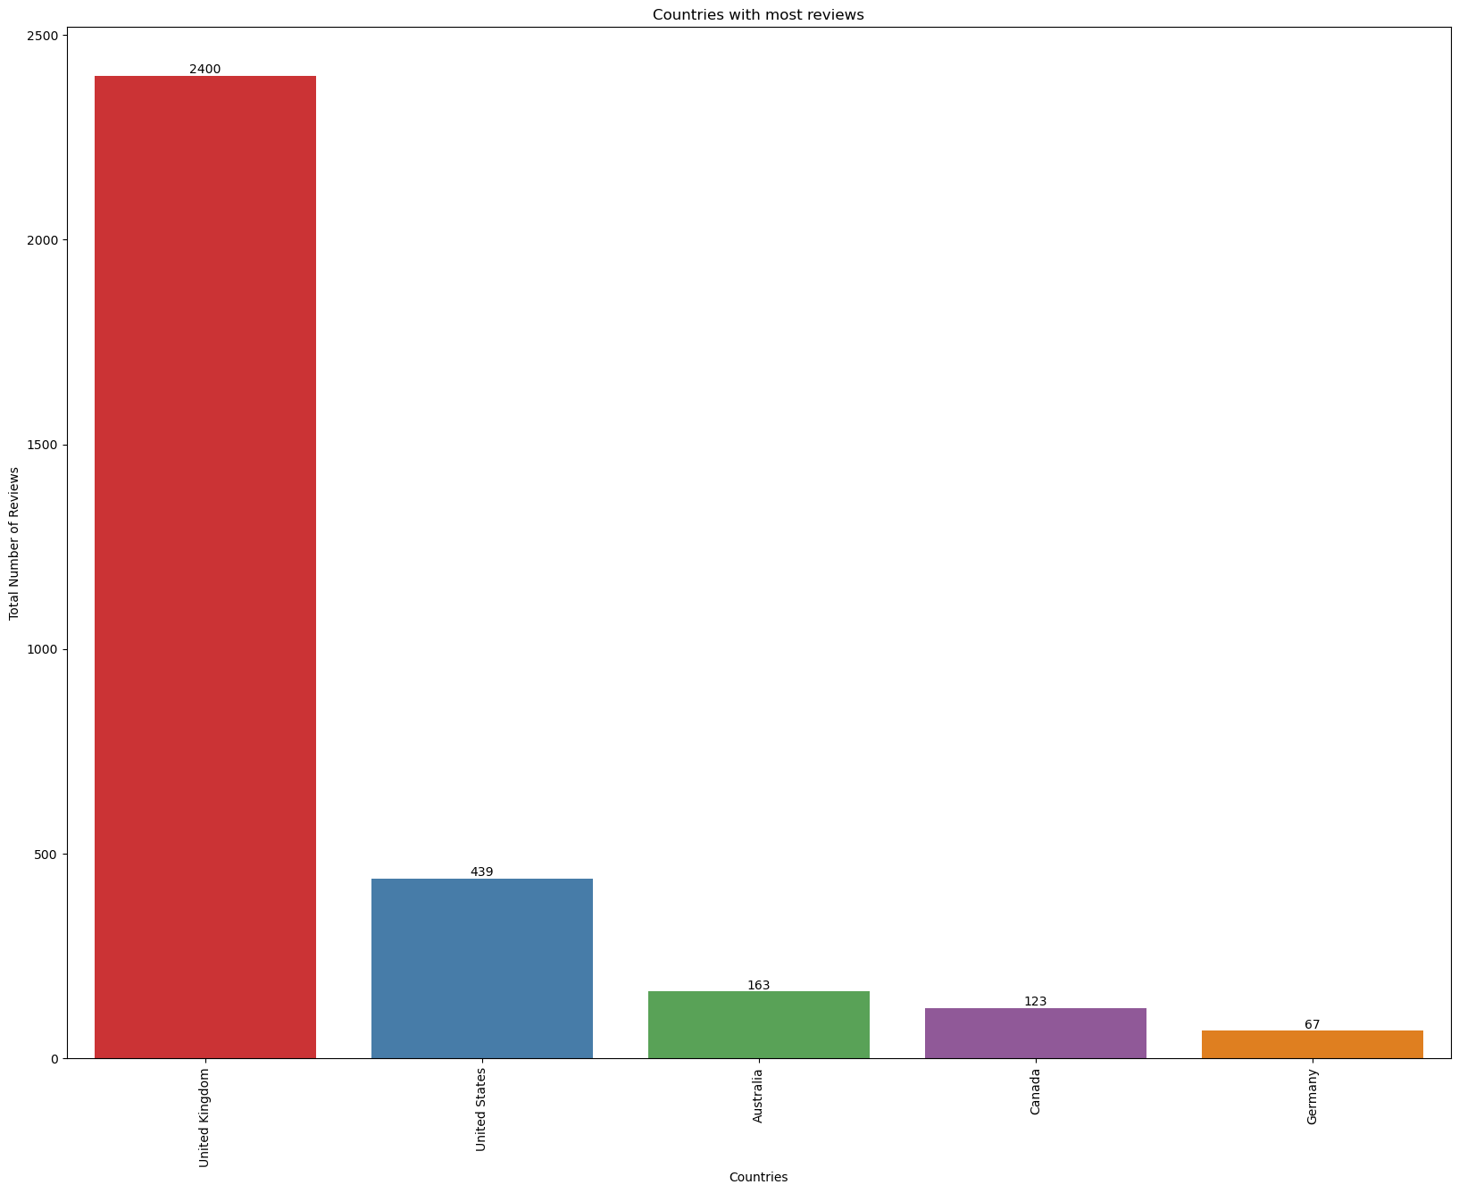
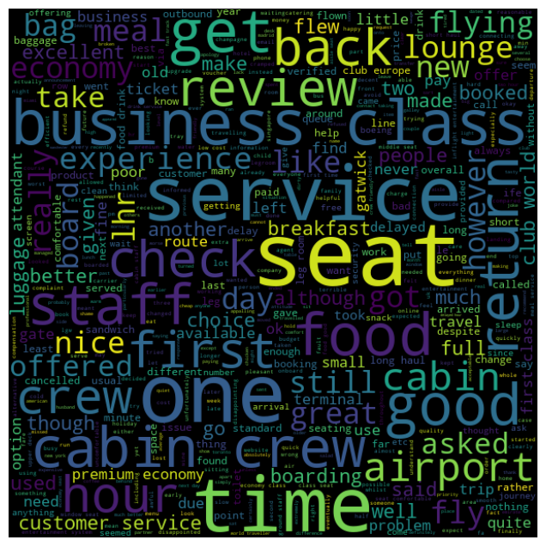
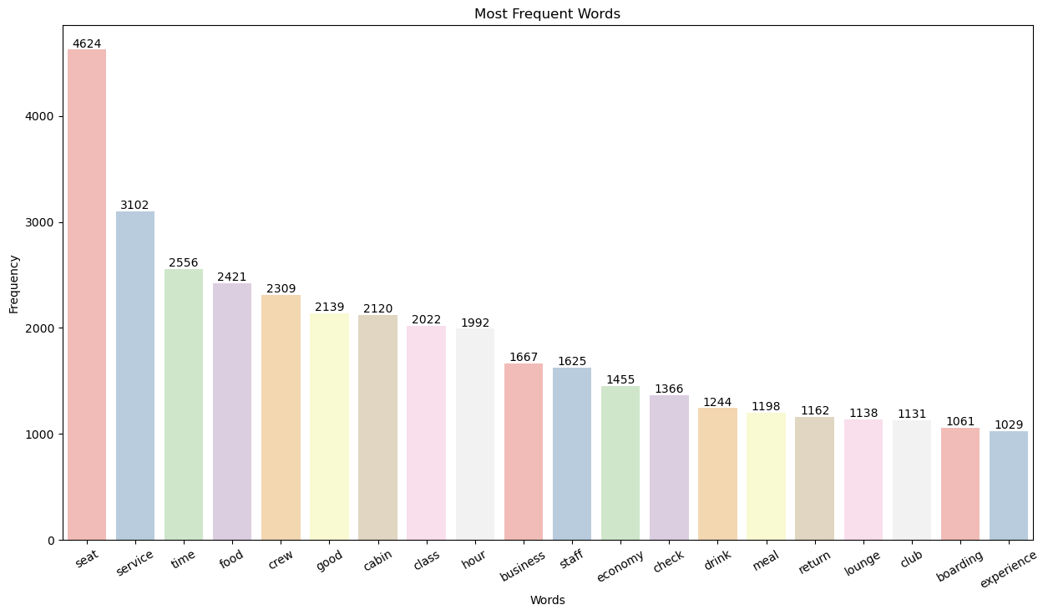

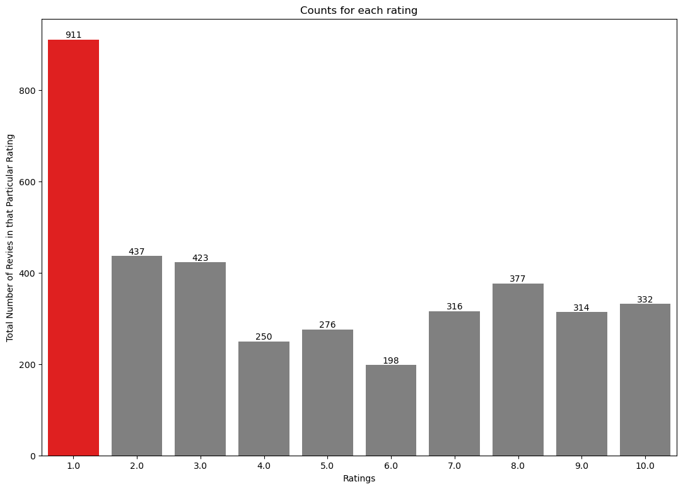
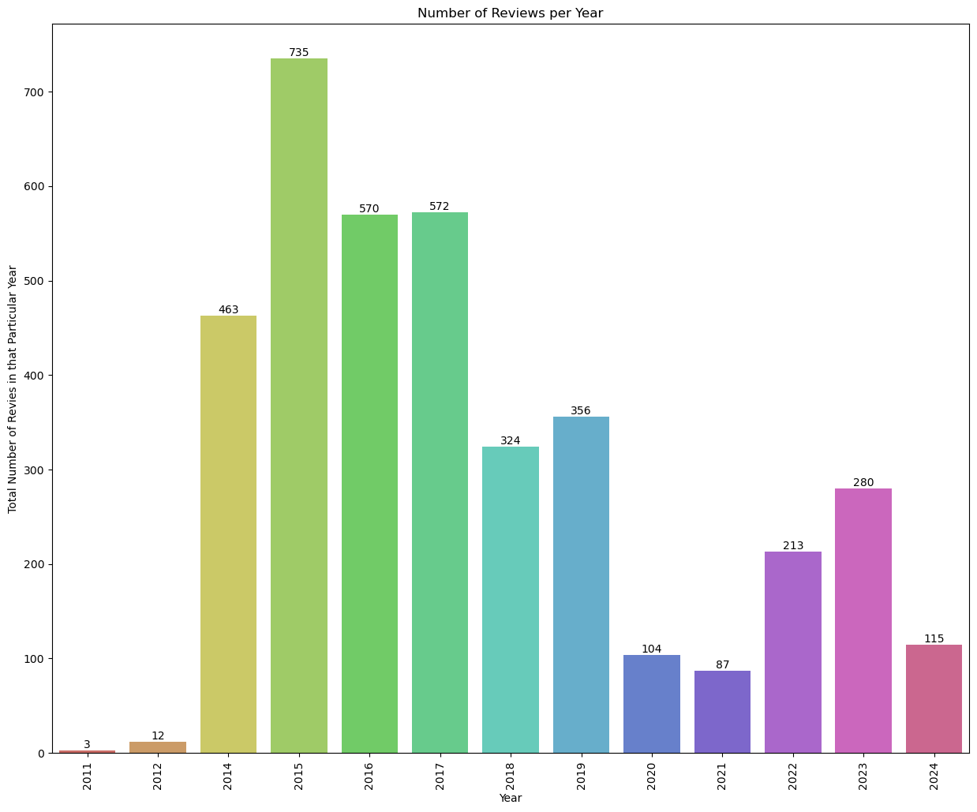
Key metrics
Average Overall Rating
4.69 /10
Reviews from 73 Countries
Total reviews
Collected -
3834
What customers are happy and unsatisfied about for different ratings class:
7-10 ratings wrote about seat layout, extra leg room, business class, good IFE, descent food quality.
4-6 ratings faced problem with old club world, upper deck window seat, long haul business, rear facing business seat.
1-3 ratings wrote dissatisfaction on congested middle seat, delay in arrival and small screen while they liked the seats and the food.
All Customers liked Cabin crew service and staff, general economy seats. Many travelled in Business class.
Focus on improving economy class service, seating comfort, and enhancing inflight entertainment, with particular attention to minimizing delays. For business class, the priority is to elevate the overall experience, as customers increasingly seek value for their money. Additionally, enhance the efficiency and responsiveness of customer service, especially in handling refund requests and processes.

